Slide 1
Introduction to Recommender Systems
Chin-Hui Lai
Department of Information Management
Chung Yuan Christian University
chlai@cycu.edu.tw

Slide 2
Agenda
What are recommender systems for?
  Introduction
How do they work (Part I) ?
  Collaborative Filtering: user-based and item-based
How to measure their success?
  Evaluation techniques

Slide 3
Introduction

Slide 4


Slide 5

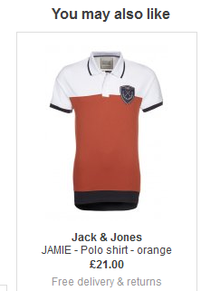
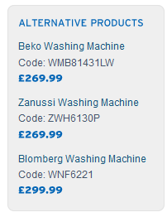
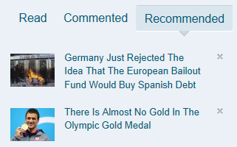
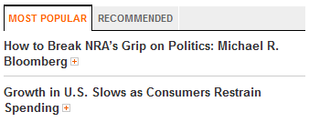
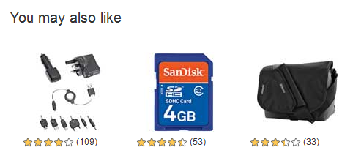
Recommender Systems
Application areas

Slide 6
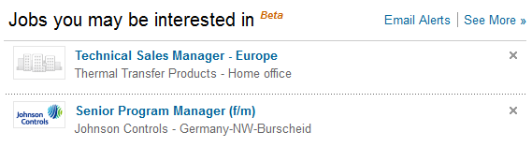
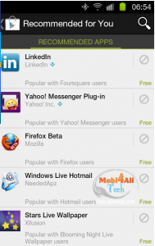
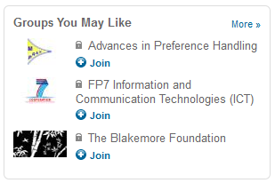
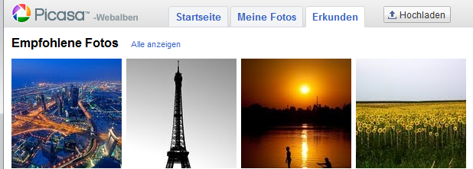
In the Social Web

Slide 7
What is recommendation system?
What is recommendation system?
  https://youtu.be/gxXn9LDAdcU
How YouTube knows what you should watch
  https://youtu.be/kiInh5STnyQ

Slide 8
Why using Recommender Systems?
Value for the customer
  Find things that are interesting
  Narrow down the set of choices
  Help me explore the space of options
  Discover new things
  Entertainment
  …
Value for the provider
  Additional and probably unique personalized service for the customer
  Increase trust and customer loyalty
  Increase sales, click trough rates, conversion etc.
  Opportunities for promotion, persuasion
  Obtain more knowledge about customers
  …

Slide 9
Real-world check
Myths from industry
  Amazon.com generates X percent of their sales through the recommendation lists (30 < X < 70)
  Netflix (DVD rental and movie streaming) generates X percent of their sales through the recommendation lists (30 < X < 70)
There must be some value in it
  See recommendation of groups, jobs or people on LinkedIn
  Friend recommendation and ad personalization on Facebook
  Song recommendation at last.fm
  News recommendation at Forbes.com (plus 37% CTR)
Academia
  A few studies exist that show the effect
    increased sales, changes in sales behavior

Slide 10



Problem domain
Recommendation systems (RS) help to match users with items
  Ease information overload
  Sales assistance (guidance, advisory, persuasion,…)
  RS are software agents that elicit the interests and preferences of individual consumers […] and make recommendations accordingly.
  They have the potential to support and improve the quality of the
  decisions consumers make while searching for and selecting products online.
        [Xiao & Benbasat, MISQ, 2007]
Different system designs / paradigms
  Based on availability of exploitable data
  Implicit and explicit user feedback
  Domain characteristics

Slide 11
Recommender systems
RS seen as a function [AT05]
Given:
  User model (e.g. ratings, preferences, demographics, situational context)
  Items (with or without description of item characteristics)
Find:
  Relevance score. Used for ranking.
Finally:
  Recommend items that are assumed to be relevant
But:
  Remember that relevance might be context-dependent
  Characteristics of the list itself might be important (diversity)

Slide 12
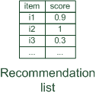

Paradigms of recommender systems
Recommender systems reduce information overload by estimating relevance

Slide 13


Paradigms of recommender systems
Personalized recommendations

Slide 14

Paradigms of recommender systems
Collaborative: "Tell me what's popular among my peers"

Slide 15

Paradigms of recommender systems
Content-based: "Show me more of the same what I've liked"

Slide 16


Paradigms of recommender systems
Knowledge-based: "Tell me what fits based on my needs"

Slide 17
Paradigms of recommender systems
Hybrid: combinations of various inputs and/or composition of different mechanism

Slide 18


Recommender systems: basic techniques
 | Pros | Cons
Collaborative | No knowledge-engineering effort, serendipity of results, learns market segments | Requires some form of rating feedback, cold start for new users and new items
Content-based | No community required, comparison between items possible | Content descriptions necessary, cold start for new users, no surprises
Knowledge-based | Deterministic recommendations, assured quality, no cold-start, can resemble sales dialogue | Knowledge engineering effort to bootstrap, basically static, does not react to short-term trends

Slide 19
Collaborative Filtering

Slide 20
Collaborative Filtering (CF)
The most prominent approach to generate recommendations
  used by large, commercial e-commerce sites
  well-understood, various algorithms and variations exist
  applicable in many domains (book, movies, DVDs, ..)
Approach
  use the "wisdom of the crowd" to recommend items
Basic assumption and idea
  Users give ratings to catalog items (implicitly or explicitly)
  Customers who had similar tastes in the past, will have similar tastes in the future

Slide 21
User-based nearest-neighbor collaborative filtering (1/2)
The basic technique:
  Given an "active user" (Alice) and an item I not yet seen by Alice
  The goal is to estimate Alice's rating for this item, e.g., by
    find a set of users (peers) who liked the same items as Alice in the past and who have rated item I
    use, e.g. the average of their ratings to predict, if Alice will like item I
    do this for all items Alice has not seen and recommend the best-rated
 | Item1 | Item2 | Item3 | Item4 | Item5
Alice | 5 | 3 | 4 | 4 | ?
User1 | 3 | 1 | 2 | 3 | 3
User2 | 4 | 3 | 4 | 3 | 5
User3 | 3 | 3 | 1 | 5 | 4
User4 | 1 | 5 | 5 | 2 | 1

Slide 22
User-based nearest-neighbor collaborative filtering (2/2)
Some first questions
  How do we measure similarity?
  How many neighbors should we consider?
  How do we generate a prediction from the neighbors' ratings?
 | Item1 | Item2 | Item3 | Item4 | Item5
Alice | 5 | 3 | 4 | 4 | ?
User1 | 3 | 1 | 2 | 3 | 3
User2 | 4 | 3 | 4 | 3 | 5
User3 | 3 | 3 | 1 | 5 | 4
User4 | 1 | 5 | 5 | 2 | 1

Slide 23


Measuring user similarity
A popular similarity measure in user-based CF: Pearson correlation
  a, b : users
  r_{a,p} : rating of user a for item p
  : user's average ratings
  P : set of items, rated both by a and b
  Possible similarity values between -1 and 1
$\overline{r_{a}}$, $\overline{r_{b}}$
 | Item1 | Item2 | Item3 | Item4 | Item5
Alice | 5 | 3 | 4 | 4 | ?
User1 | 3 | 1 | 2 | 3 | 3
User2 | 4 | 3 | 4 | 3 | 5
User3 | 3 | 3 | 1 | 5 | 4
User4 | 1 | 5 | 5 | 2 | 1
sim = 0.85
sim = 0.70
sim = -0.79

Slide 24
Pearson correlation
Takes differences in rating behavior into account
Works well in usual domains, compared with alternative measures
  such as cosine similarity

Slide 25
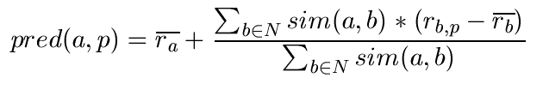
Making predictions
A common prediction function:
Calculate, whether the neighbors' ratings for the unseen item i are higher or lower than their average
Combine the rating differences – use the similarity as a weight
Add/subtract the neighbors' bias from the active user's average and use this as a prediction

Slide 26
Making recommendations
Making predictions is typically not the ultimate goal
Usual approach (in academia)
  Rank items based on their predicted ratings
However
  This might lead to the inclusion of (only) niche items
  In practice also: Take item popularity into account
Approaches
  "Learning to rank"
    Optimize according to a given rank evaluation metric (see later)

Slide 27
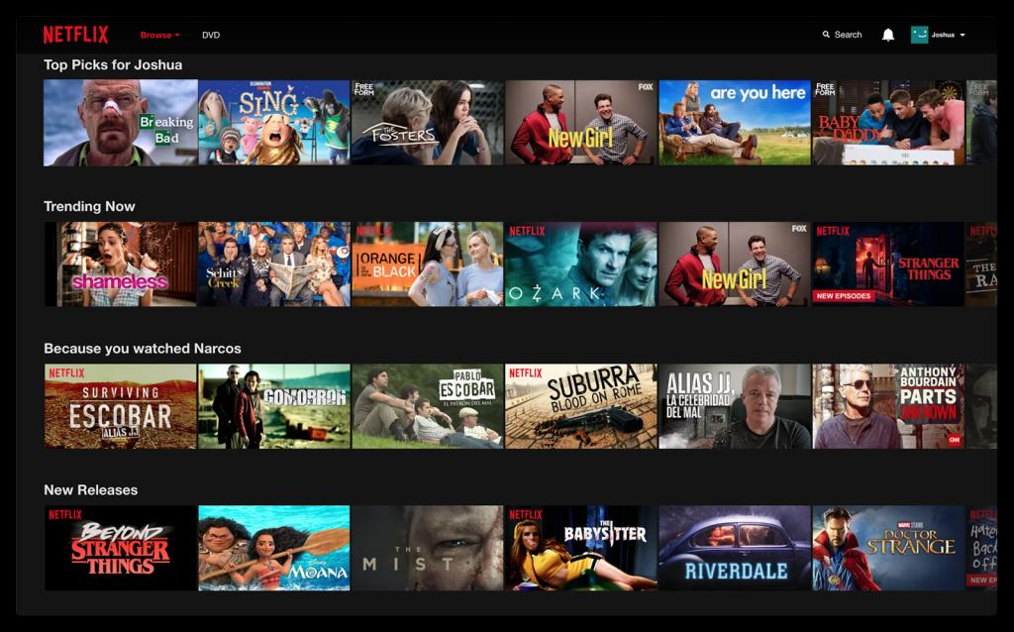
Application: Netflix
Netflix recommendation
  https://youtu.be/nq2QtatuF7U
  https://youtu.be/WtEGLUXY2u4
Ref: https://recostream.com/blog/recommendation-system-netflix

Slide 28
Improving the metrics / prediction function
Not all neighbor ratings might be equally "valuable"
  Agreement on commonly liked items is not so informative as agreement on controversial items
  Possible solution: Give more weight to items that have a higher variance
Value of number of co-rated items
  Use "significance weighting", by e.g., linearly reducing the weight when the number of co-rated items is low
Case amplification
  Intuition: Give more weight to "very similar" neighbors, i.e., where the similarity value is close to 1.
Neighborhood selection
  Use similarity threshold or fixed number of neighbors

Slide 29
Memory-based and model-based approaches
User-based CF is said to be "memory-based"
  the rating matrix is directly used to find neighbors / make predictions
  does not scale for most real-world scenarios
  large e-commerce sites have tens of millions of customers and millions of items
Model-based approaches
  based on an offline pre-processing or "model-learning" phase
  at run-time, only the learned model is used to make predictions
  models are updated / re-trained periodically
  large variety of techniques used
  model-building and updating can be computationally expensive

Slide 30
Item-based collaborative filtering
Basic idea:
  Use the similarity between items (and not users) to make predictions
Example:
  Look for items that are similar to Item5
  Take Alice's ratings for these items to predict the rating for Item5
 | Item1 | Item2 | Item3 | Item4 | Item5
Alice | 5 | 3 | 4 | 4 | ?
User1 | 3 | 1 | 2 | 3 | 3
User2 | 4 | 3 | 4 | 3 | 5
User3 | 3 | 3 | 1 | 5 | 4
User4 | 1 | 5 | 5 | 2 | 1

Slide 31


The cosine similarity measure
Produces better results in item-to-item filtering
  for some datasets, no consistent picture in literature
Ratings are seen as vector in n-dimensional space
Similarity is calculated based on the angle between the vectors
Adjusted cosine similarity
  take average user ratings into account, transform the original ratings
  U: set of users who have rated both items a and b

Slide 32
Pre-processing for item-based filtering
Item-based filtering does not solve the scalability problem itself
Pre-processing approach by Amazon.com (in 2003)
  Calculate all pair-wise item similarities in advance
  The neighborhood to be used at run-time is typically rather small, because only items are taken into account which the user has rated
  Item similarities are supposed to be more stable than user similarities
Memory requirements
  Up to N² pair-wise similarities to be memorized (N = number of items) in theory
  In practice, this is significantly lower (items with no co-ratings)
  Further reductions possible
    Minimum threshold for co-ratings (items, which are rated at least by n users)
    Limit the size of the neighborhood (might affect recommendation accuracy)

Slide 33
More on ratings
Pure CF-based systems only rely on the rating matrix
Explicit ratings
  Most commonly used (1 to 5, 1 to 7 Likert response scales)
  Research topics
    "Optimal" granularity of scale; indication that 10-point scale is better accepted in movie domain
    Multidimensional ratings (multiple ratings per movie)
  Challenge
    Users not always willing to rate many items; sparse rating matrices
    How to stimulate users to rate more items?
Implicit ratings
  clicks, page views, time spent on some page, demo downloads …
  Can be used in addition to explicit ones; question of correctness of interpretation

Slide 34
Data sparsity problems
Cold start problem
  How to recommend new items? What to recommend to new users?
Straightforward approaches
  Ask/force users to rate a set of items
  Use another method (e.g., content-based, demographic or simply non-personalized) in the initial phase
Alternatives
  Use better algorithms (beyond nearest-neighbor approaches)
  Example:
    In nearest-neighbor approaches, the set of sufficiently similar neighbors might be to small to make good predictions
    Assume "transitivity" of neighborhoods

Slide 35
Example algorithms for sparse datasets
Recursive CF
  Assume there is a very close neighbor n of u who however has not rated the target item i yet.
  Idea:
    Apply CF-method recursively and predict a rating for item i for the neighbor
    Use this predicted rating instead of the rating of a more distant direct neighbor
 | Item1 | Item2 | Item3 | Item4 | Item5
Alice | 5 | 3 | 4 | 4 | ?
User1 | 3 | 1 | 2 | 3 | ?
User2 | 4 | 3 | 4 | 3 | 5
User3 | 3 | 3 | 1 | 5 | 4
User4 | 1 | 5 | 5 | 2 | 1
sim = 0.85
Predict rating for
User1

Slide 36
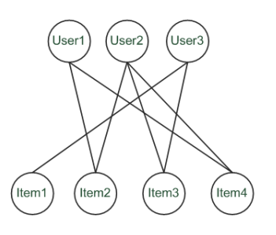
Graph-based methods
"Spreading activation" (sketch)
  Idea: Use paths of lengths > 3 to recommend items
  Length 3: Recommend Item3 to User1
  Length 5: Item1 also recommendable

Slide 37
More model-based approaches
Plethora of different techniques proposed in the last years, e.g.,
  Matrix factorization techniques, statistics
    singular value decomposition, principal component analysis
  Association rule mining
    compare: shopping basket analysis
  Probabilistic models
    clustering models, Bayesian networks, probabilistic Latent Semantic Analysis
  Various other machine learning approaches
Costs of pre-processing
  Usually not discussed
  Incremental updates possible?

Slide 38
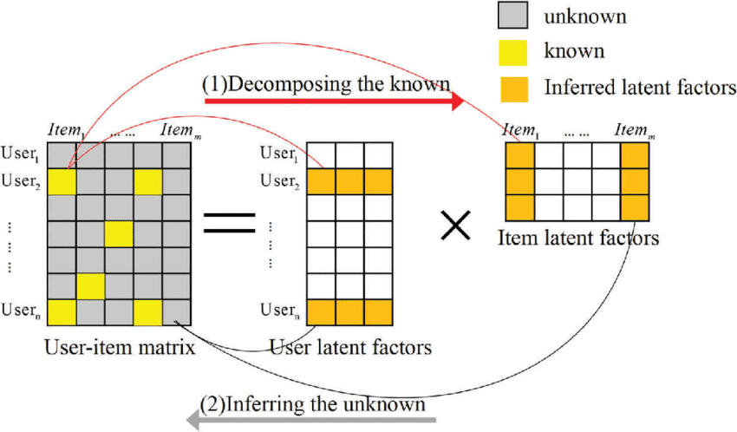
Matrix factorization (1/2)
https://www.researchgate.net/figure/Diagram-of-matrix-factorization_fig1_321344494

Slide 39
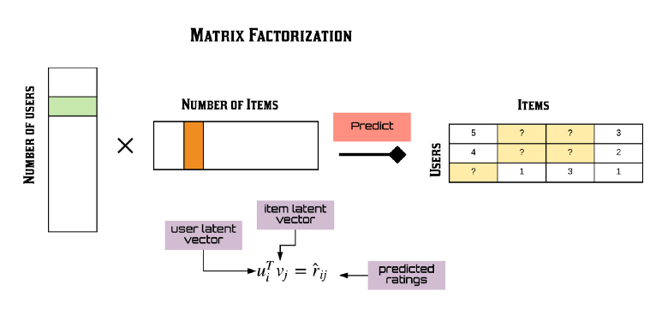
Matrix factorization (2/2)
https://towardsdatascience.com/recsys-series-part-4-the-7-variants-of-matrix-factorization-for-collaborative-filtering-368754e4fab5
Reference:
1. Matrix Factorization Explained https://www.mygreatlearning.com/blog/matrix-factorization-explained/
2. Matrix Factorization implementation https://developers.google.com/machine-learning/recommendation/collaborative/basics?hl=en
3. [Paper] Matrix factorization techniques for recommender systems
https://datajobs.com/data-science-repo/Recommender-Systems-%5BNetflix%5D.pdf

Slide 40
Association rule mining
Commonly used for shopping behavior analysis
  aims at detection of rules such as
  "If a customer purchases baby-food then he also buys diapers
  in 70% of the cases"
Association rule mining algorithms
  can detect rules of the form X => Y (e.g., baby-food => diapers) from a set of sales transactions D = {t₁, t₂, … t_{n}}
  measure of quality: support, confidence

Slide 41
Probabilistic methods
Basic idea (simplistic version for illustration):
  given the user/item rating matrix
  determine the probability that user Alice will like an item i
  base the recommendation on such these probabilities
Calculation of rating probabilities based on Bayes Theorem
  How probable is rating value "1" for Item5 given Alice's previous ratings?
  Corresponds to conditional probability P(Item5=1 | X), where
    X = Alice's previous ratings = (Item1 =1, Item2=3, Item3= … )
  Can be estimated based on Bayes' Theorem
Usually more sophisticated methods used
  Clustering
  pLSA …

Slide 42
Summarizing recent methods
Recommendation is concerned with learning from noisy observations
(x, y), where
has to be determined such that
is minimal.
A variety of different learning strategies have been applied trying to estimate f(x)
  Non parametric neighborhood models
  MF models, SVMs, Neural Networks, Bayesian Networks,…

Slide 43
Collaborative Filtering Issues
Pros:
  well-understood, works well in some domains, no knowledge engineering required
Cons:
  requires user community, sparsity problems, no integration of other knowledge sources, no explanation of results
What is the best CF method?
  In which situation and which domain? Inconsistent findings; always the same domains and data sets; differences between methods are often very small (1/100)
How to evaluate the prediction quality?
  MAE / RMSE: What does an MAE of 0.7 actually mean?
  Serendipity: Not yet fully understood
What about multi-dimensional ratings?

Slide 44
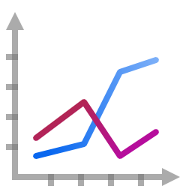
Evaluation of Recommender Systems

Slide 45

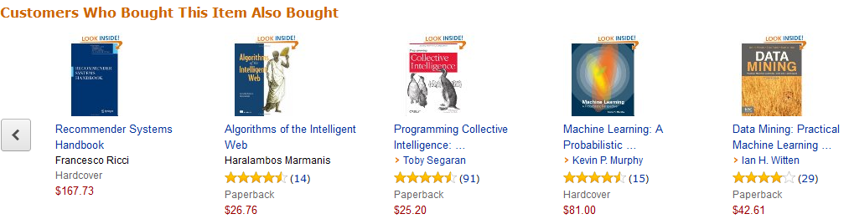
Recommender Systems in e-Commerce
One Recommender Systems research question
  What should be in that list?

Slide 46
Recommender Systems in e-Commerce
Another question both in research and practice
  How do we know that these are good recommendations?

Slide 47

Recommender Systems in e-Commerce
This might lead to …
  What is a good recommendation?
  What is a good recommendation strategy?
  What is a good recommendation strategy for my business?
We hope you will buy also …
These have been in stock for quite a while now …

Slide 48



What is a good recommendation?
What are the measures in practice?
  Total sales numbers
  Promotion of certain items
  …
  Click-through-rates
  Interactivity on platform
  …
  Customer return rates
  Customer satisfaction and loyalty

Slide 49
Purpose and success criteria (1)
Different perspectives/aspects
  Depends on domain and purpose
  No holistic evaluation scenario exists
Retrieval perspective
  Reduce search costs
  Provide "correct" proposals
  Assumption: Users know in advance what they want
Recommendation perspective
  Serendipity – identify items from the Long Tail
  Users did not know about existence
Notes:
Could a RS be a persuasive technology? In fact depending on the application area RS are deployed to:

Slide 50
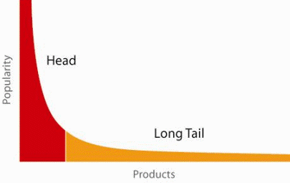
When does a RS do its job well?
"Recommend widely unknown items that users might actually like!"
20% of items accumulate 74% of all positive ratings
Recommend items
from the long tail

Slide 51
Purpose and success criteria (2)
Prediction perspective
  Predict to what degree users like an item
  Most popular evaluation scenario in research
Interaction perspective
  Give users a "good feeling"
  Educate users about the product domain
  Convince/persuade users - explain
Finally, conversion perspective
  Commercial situations
  Increase "hit", "clickthrough", "lookers to bookers" rates
  Optimize sales margins and profit

Slide 52





How do we as researchers know?
Test with real users
  A/B tests
  Example measures: sales increase, click through rates
Laboratory studies
  Controlled experiments
  Example measures: satisfaction with the system (questionnaires)
Offline experiments
  Based on historical data
  Example measures: prediction accuracy, coverage

Slide 53
Empirical research
Characterizing dimensions:
  Who is the subject that is in the focus of research?
  What research methods are applied?
  In which setting does the research take place?
Subject | Online customers, students, historical online sessions, computers, …
Research method | Experiments, quasi-experiments, non-experimental research
Setting | Lab, real-world scenarios

Slide 54
Research methods
Experimental vs. non-experimental (observational) research methods
  Experiment (test, trial):
    "An experiment is a study in which at least one variable is manipulated and units are randomly assigned to different levels or categories of manipulated variable(s)."
    Units: users, historic sessions, …
    Manipulated variable: type of RS, groups of recommended items,
    explanation strategies …
    Categories of manipulated variable(s): content-based RS, collaborative RS

Slide 55
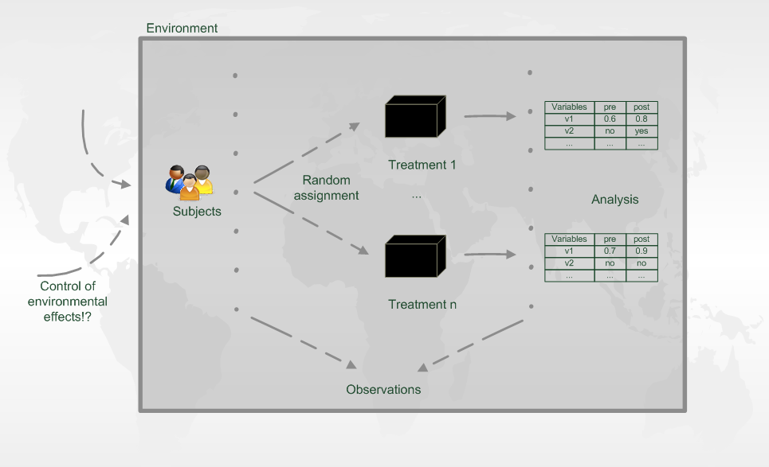
Experiment designs

Slide 56
Evaluation in information retrieval (IR)
Recommendation is viewed as information retrieval task:
  Retrieve (recommend) all items which are predicted to be "good" or "relevant".
Common protocol :
  Hide some items with known ground truth
  Rank items or predict ratings -> Count -> Cross-validate
Ground truth established by human domain experts
 |  | Reality
 |  | Actually Good | Actually Bad
Prediction | Rated Good | True Positive (tp) | False Positive (fp)
 | Rated Bad | False Negative (fn) | True Negative (tn)

Slide 57
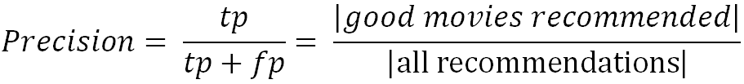
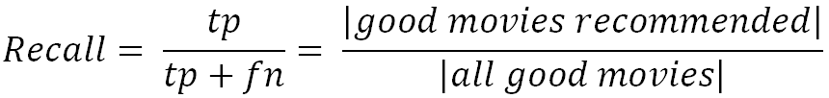
Metrics: Precision and Recall
Precision: a measure of exactness, determines the fraction of relevant items retrieved out of all items retrieved
  E.g. the proportion of recommended movies that are actually good
Recall: a measure of completeness, determines the fraction of relevant items retrieved out of all relevant items
  E.g. the proportion of all good movies recommended

Slide 58
Dilemma of IR measures in RS
IR measures are frequently applied, however:
  Ground truth for most items actually unknown
  What is a relevant item?
  Different ways of measuring precision possible
Results from offline experimentation may have limited predictive power for online user behavior.

Slide 59
Metrics: Rank Score – position matters
For a user:
Actually good
Item 237
Item 899
Recommended (predicted as good)
Item 345
Item 237
Item 187
hit
Rank Score extends recall and precision to take the positions of correct items in a ranked list into account
  Particularly important in recommender systems as lower ranked items may be overlooked by users
  Learning-to-rank: Optimize models for such measures (e.g., AUC)

Slide 60

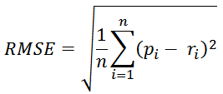
Accuracy measures
Datasets with items rated by users
  MovieLens datasets 100K-10M ratings
  Netflix 100M ratings
Historic user ratings constitute ground truth
Metrics measure error rate
  Mean Absolute Error (MAE) computes the deviation between predicted ratings and actual ratings
  Root Mean Square Error (RMSE) is similar to MAE, but places more emphasis on larger deviation

Slide 61
Offline experimentation example
Netflix competition
  Web-based movie rental
  Prize of $1,000,000 for accuracy improvement (RMSE) of 10% compared to own Cinematch system.
Historical dataset
  ~480K users rated ~18K movies on a scale of 1 to 5 (~100M ratings)
  Last 9 ratings/user withheld
    Probe set – for teams for evaluation
    Quiz set – evaluates teams’ submissions for leaderboard
    Test set – used by Netflix to determine winner
Today
  Rating prediction only seen as an additional input into the recommendation process

Slide 62
An imperfect world
Offline evaluation is the cheapest variant
  Still, gives us valuable insights
  and lets us compare our results (in theory)
Dangers and trends:
  Domination of accuracy measures
  Focus on small set of domains (40% on movies in CS)
Alternative and complementary measures:
  Diversity, Coverage, Novelty, Familiarity, Serendipity, Popularity, Concentration effects (Long tail)

Slide 63
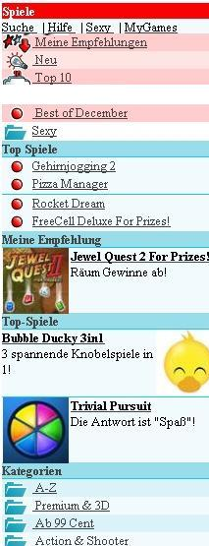
Online experimentation example
Effectiveness of different algorithms for recommending cell phone games
[Jannach, Hegelich 09]
Involved 150,000 users on a commercial mobile internet portal
Comparison of recommender methods

Slide 64
Details and results
Recommender variants included:
  Item-based collaborative filtering
  SlopeOne (also collaborative filtering)
  Content-based recommendation
  Hybrid recommendation
  Top-rated items
  Top-sellers
Findings:
  Personalized methods increased sales up to 3.6% compared to non-personalized
  Choice of recommendation algorithm depends on user situation
  (e.g. avoid content-based RS in post-sales situation)
} non-personalized

Slide 65
Non-experimental research
Quasi-experiments
  Lack random assignments of units to different treatments
Non-experimental / observational research
  Surveys / Questionnaires
  Longitudinal research
    Observations over long period of time
    E.g. customer life-time value, returning customers
  Case studies
  Focus group
    Interviews
    Think-aloud protocols

Slide 66
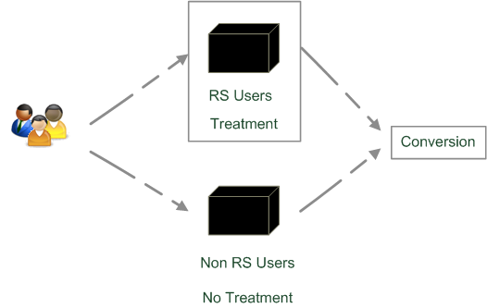
Quasi-experimental
SkiMatcher Resort Finder introduced by Ski-Europe.com to provide users with recommendations based on their preferences
Conversational RS
  question and answer dialog
  matching of user preferences with knowledge base
Delgado and Davidson evaluated the
effectiveness of the recommender over a
4 month period in 2001
  Classified as a quasi-experiment
  as users decide for themselves if they
  want to use the recommender or not

Slide 67
SkiMatcher Results
 | July | August | September | October
Unique Visitors | 10,714 | 15,560 | 18,317 | 24,416
SkiMatcher Users | 1,027 | 1,673 | 1,878 | 2,558
Non-SkiMatcher Users | 9,687 | 13,887 | 16,439 | 21,858
Requests for Proposals | 272 | 506 | 445 | 641
SkiMatcher Users | 75 | 143 | 161 | 229
Non-SkiMatcher Users | 197 | 363 | 284 | 412
Conversion | 2.54% | 3.25% | 2.43% | 2.63%
SkiMatcher Users | 7.30% | 8.55% | 8.57% | 8.95%
Non-SkiMatcher Users | 2.03% | 2.61% | 1.73% | 1.88%
Increase in Conversion | 359% | 327% | 496% | 475%
[Delgado and Davidson, ENTER 2002]

Slide 68
Interpreting the Results
The nature of this research design means that questions of causality cannot be answered (lack of random assignments), such as
  Are users of the recommender systems more likely convert?
  Does the recommender system itself cause users to convert?
  Some hidden exogenous variable might influence the choice of using RS as well as conversion.
However, significant correlation between using the recommender system and making a request for a proposal
Size of effect has been replicated in other domains
  Tourism [Jannach et al., JITT 2009]
  Electronic consumer products

Slide 69
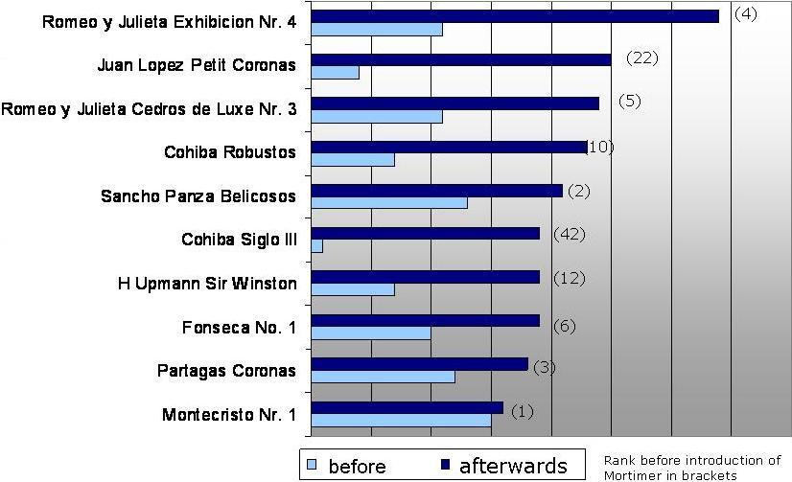
Observational research
Increased demand in niches/long tail products
  Ex-post from web shop data [Zanker et al., EC-Web, 2006]

